Slide 1
EU LGBT Survey European Union lesbian, gay, bisexual and transgender survey (2012)
FRA (fundamental rights agency) conducted an online survey to identify how lesbian, gay, bisexual and transgender (lgbt) people living in the European union and Croatia experience the fulfilment of their fundamental rights. the evidence produced by the survey will support the development of more effective laws and policies to fight discrimination, violence and harassment, improving equal treatment across society

Slide 2
LGBT Survey Analysis:
Objectives :
Analyzing data to find insights that would help the decision making
Technology used for Analysis :
R

Slide 3
Dataset description:
Data sets has

Slide 4
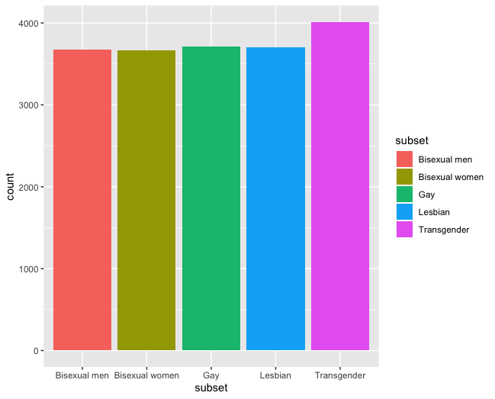
Q1: What are the LGBT groups and their account

Slide 5
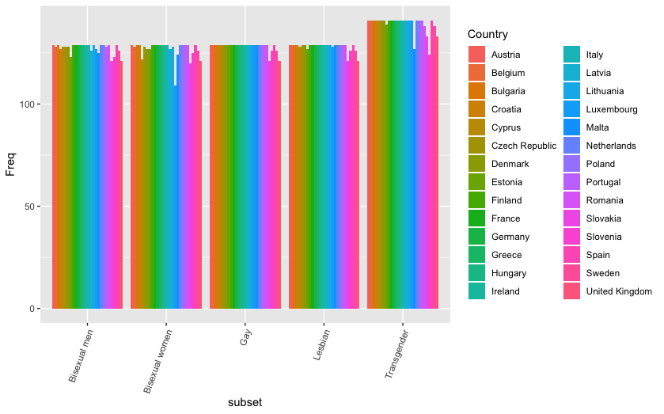
Q2: LGBT Distribution over each country

Slide 6
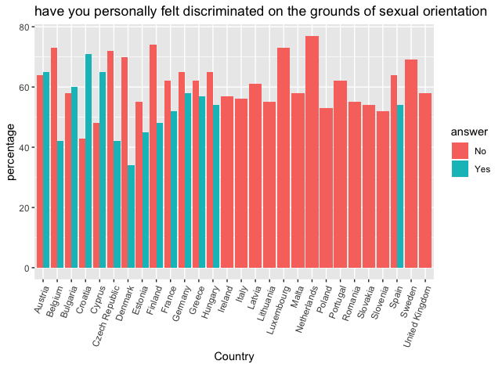
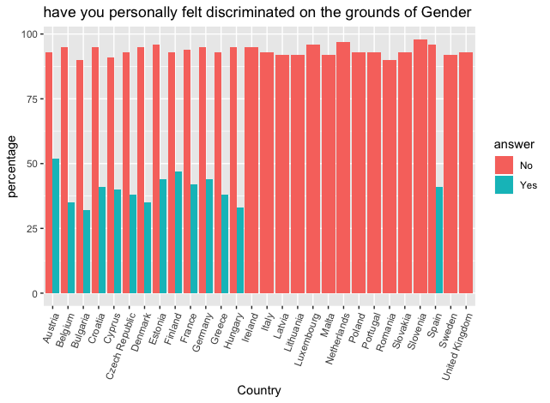
Q3&4 In last 12 month in where country you live have you personally felt discriminated against or harassed on the ground of sexual orientation or gender

Slide 7
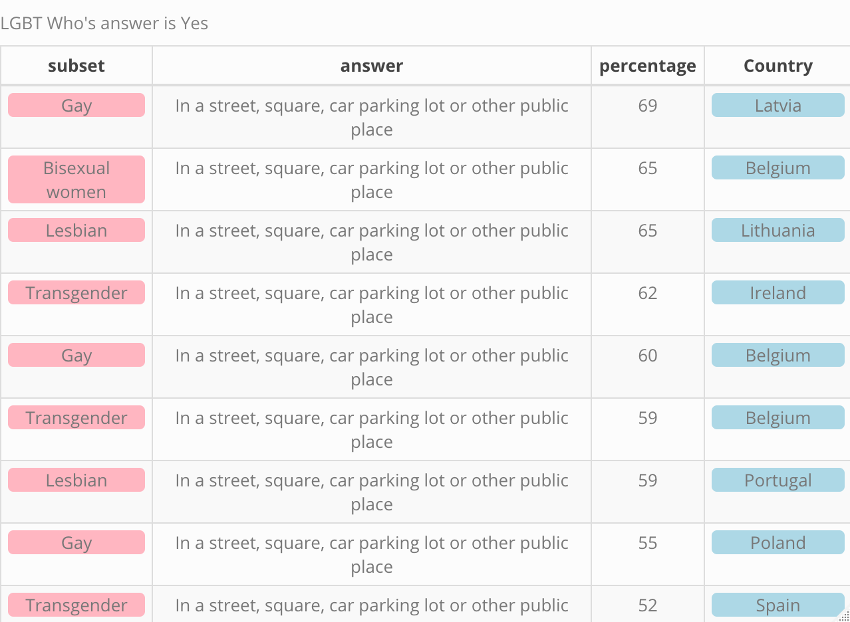
Q5 Where did the last incident of physical / sexual attack or threat of violence happen in last 12 month

Slide 8
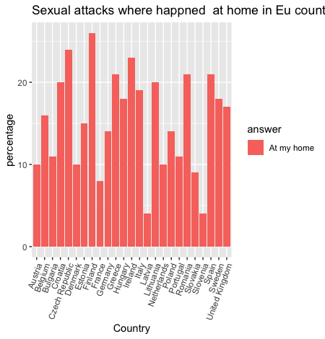
Q6 Where (In which country) did the last incident of physical / sexual attack or threat of violence happen At my home

Slide 9
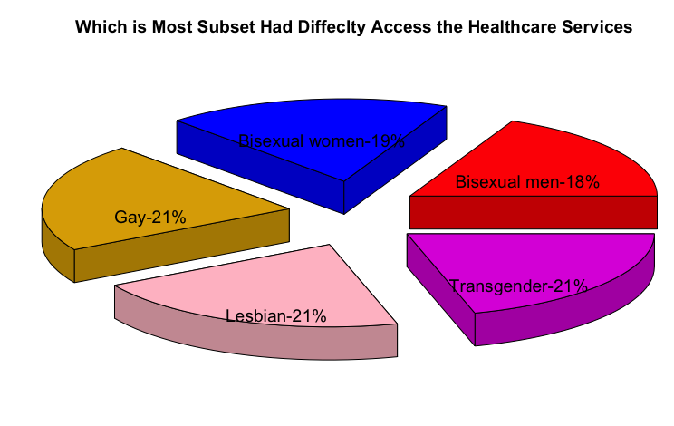
Q7 Which subset has more difficulty accessing the healthcare services

Slide 10
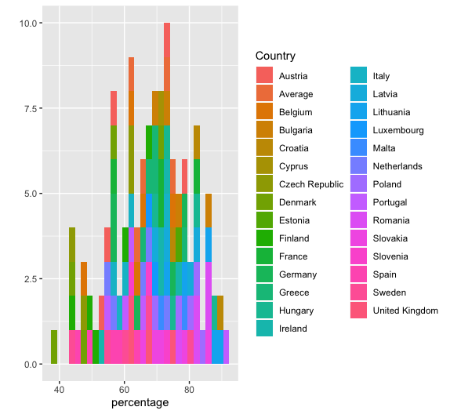
Q8-Which Country LGBT community avoid begin open about themselves ?

Slide 11
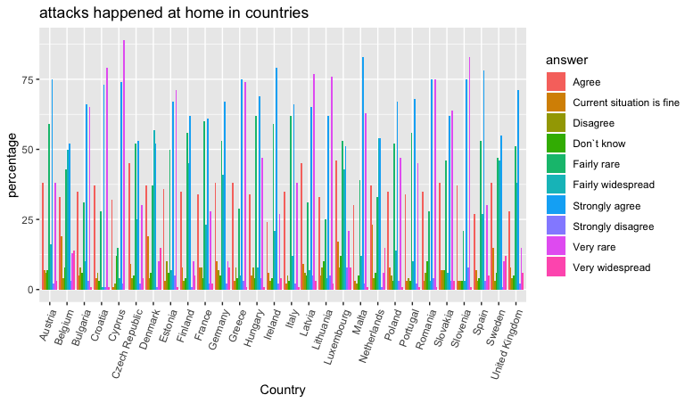
Q10 which country less supported LGBT community by public figures in politics, business,? Is that would help if it otherwise?

Slide 12
Q10 in daily life activities which is the most comfortably living country

Slide 13
Conclusion
The Most LGBT friendly country is Czech Republic
Transgender sample is bit higher however, they are not the most felt discriminated moreover accessing healthcare service was equally difficult for Lesbian ,Gay too with all 21% each.
Czech Republic ,Finland and Ireland are countries which where most the sexual attack , or threat of violence happens at Homes .
sexual in public and home for both Ireland and Finland are both higher however Czech Republic is almost the same
Latvia is has the lowest sexual attack , or threat of violence domestically and the highest when it comes to public
60 to 80% of LGBT are avoid begin open about themselves specially in public transportation
Cypress had 0 support for LGBT specially by public figures in politics ,sport and so on

Slide 14
Conclusion
Daily life activities :
Looking For Job,
Buying Property,
Social service Access
University or School

